Slide 1
Brain Tumor Classification
Capstone 2

Slide 2
Brain Tumors
Brain tumors are a growth of abnormal cells in your brain
They can be malignant (cancerous) or benign (non-cancerous)
They can be hard to diagnose
Some tumors have no symptoms until they get quite large and dangerous
The best technique to diagnose a brain tumor is Magnetic Resource Imaging

Slide 3
Types of Tumors in this Study
Glioma is a type of tumor that occurs in the brain and spinal cord
Pituitary is a tumor that forms in the pituitary gland near the brain that can cause changes in hormone levels in the body
Meningioma is a tumor that forms on membranes that cover the brain and spinal cord just inside the skull
No tumor is the final classification and the best outcome

Slide 4
Data
Dataset used was from https://www.kaggle.com/sartajbhuvaji/brain-tumor-classification-mri
It contains two folders Training and Testing
Training has four sub folders named pituitary_tumor (826), no_tumor (822), meningioma_tumor (395) and glioma_tumor (827)
Testing has four sub folders named pituitary_tumor (100), no_tumor (115), meningioma_tumor (105) and glioma_tumor (74)

Slide 5
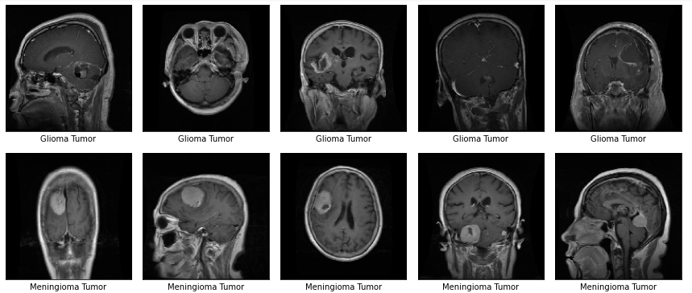
Data Viewing the Files
Glioma tumor and Meningioma tumor

Slide 6
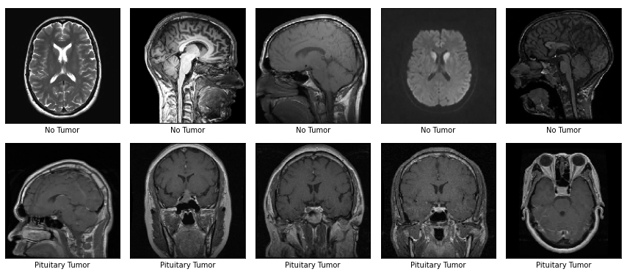
Data Viewing the Files Part 2
No tumor and Pituitary tumor

Slide 7
Preprocessing
Convert training and testing data to numpy array
Then apply label encoding
Used Keras flow_from_directory to change target to category

Slide 8
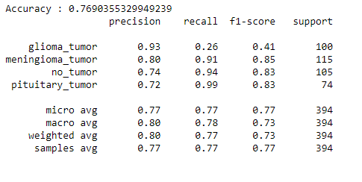
Model 1
The first model tested was Convolutional Neural Network, CNN
Results achieved:

Slide 9
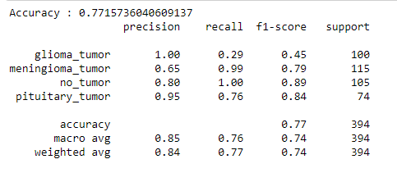
Model 2
Transfer learning was the next I tried using VGG19
Results achieved:

Slide 10
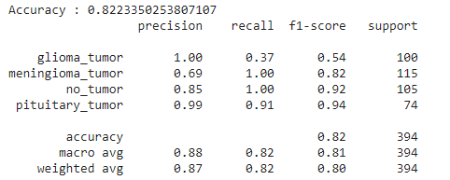
Model 3
The third model tested was also transfer learning, using Resnet50
Results achieved:

Slide 11
Conclusions
All three models ran okay
All three models had accuracy issues, especially with glioma tumors
All models performed better on the pituitary and no tumor classifications
The Resnet5o performed the best of all the models on the pituitary class

